Slide 1
Student Collaborative and Learning Management System
REVIEW – 1
Requirement Analysis Document (RAD) &
System Design Document
Student Name
K. Mahitha Komali
Roll No: 2023002185
BCA VI Semester
Project Guide
Mr. G. Ramesh Naidu
Assistant Professor

Slide 2
Introduction
The Student Collaborative and Learning Management System is a web-based application developed to support effective peer learning and academic collaboration among students. It provides a centralized platform where students can create study groups, collaborate on academic projects, and share learning resources and academic opportunities in an organized manner.
Purpose of the System
The purpose of this system is to support organized and efficient academic collaboration in educational institutions. It was developed to meet the growing need for a reliable platform as academic workloads and group activities increase. By offering a secure and institution-focused solution, the system helps improve communication, teamwork, and achievement of academic goals.

Slide 3
Scope of the System
The scope of the Student Collaborative and Learning Management System includes secure student registration and authentication, creation and management of study groups, project collaboration features, group discussions, and sharing of internship-related information. The system is designed for use within academic institutions and supports real-time interaction and efficient group management.
Objectives of the Project
To improve peer learning through collaborative study groups
To strengthen teamwork and academic interaction among students
To simplify project collaboration and information sharing
Success Criteria of the Project
Active participation of students on the platform
Secure handling of user data and authentication
Effective communication and collaboration among users

Slide 4
Current System
In the existing approach, students rely on informal methods such as social media platforms, messaging applications, and personal contacts for academic collaboration. These methods lack structure, proper organization, and academic alignment, making it difficult to form suitable study groups, manage projects efficiently, and ensure equal access to academic opportunities.
Proposed System
The proposed system is a centralized web-based platform that enables students to collaborate in a structured and organized manner. It provides secure access, study group management, project collaboration tools, discussion forums, and mechanisms for sharing internship-related information. The system ensures real-time interaction and improved coordination among students within an academic environment.
Advantages of the Proposed System
Scalability
Security
Collaboration

Slide 5
Functional Requirements
The system shall allow students to register and log in securely
The system shall enable students to create, search, and join study groups
The system shall support project idea sharing and collaboration
The system shall provide group discussion and communication features
The system shall allow students to share internship and academic opportunities
Student registration details (name, email, department, etc.)
Login credentials
Study group and project information
User dashboards after successful login
Lists of available study groups and projects
Display of internship and academic opportunity details
Non-Functional Requirements
Usability
Security
Reliability
Availability

Slide 6
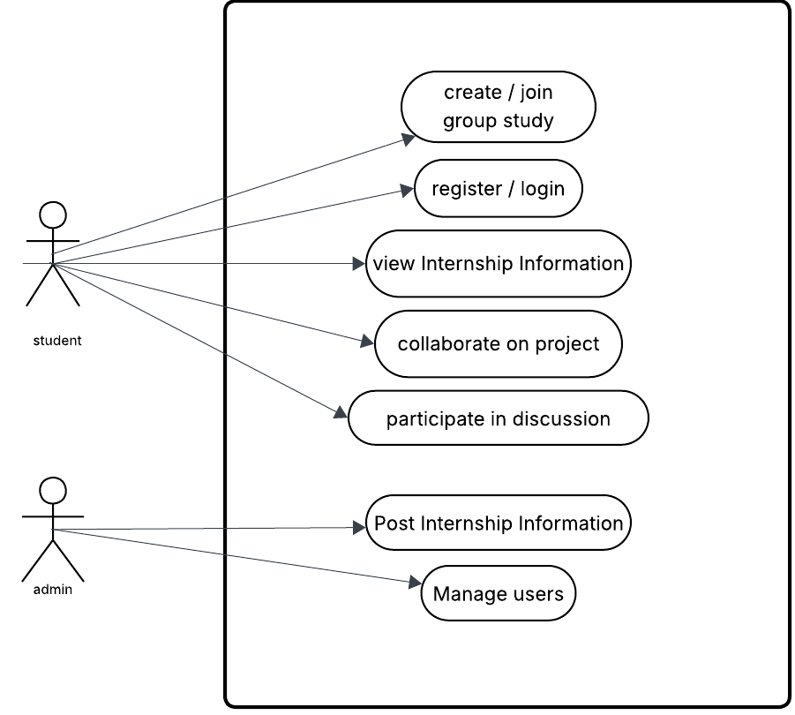
Usecase Model

